Slide 1
abstract factory design pattern
Akhil Chary

Slide 2
Introduction
Abstract Factory is a creational design pattern that lets you produce families of related objects without specifying their concrete classes.

Slide 3
Definition
Abstract Factory Pattern says that just define an interface or abstract class for creating families of related (or dependent) objects but without specifying their concrete sub-classes.

Slide 4
Usage of Abstract Factory Pattern
When the system needs to be independent of how its object are
created, composed, and represented.
When the family of related objects has to be used together,
then this constraint needs to be enforced.

Slide 5
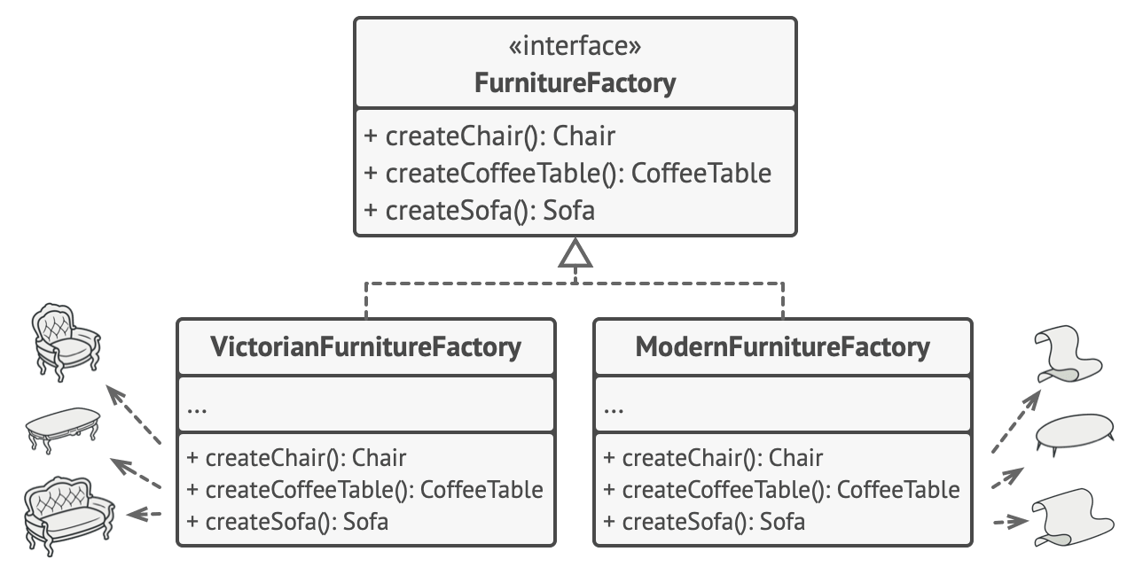

Slide 6
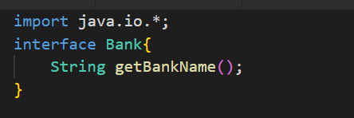
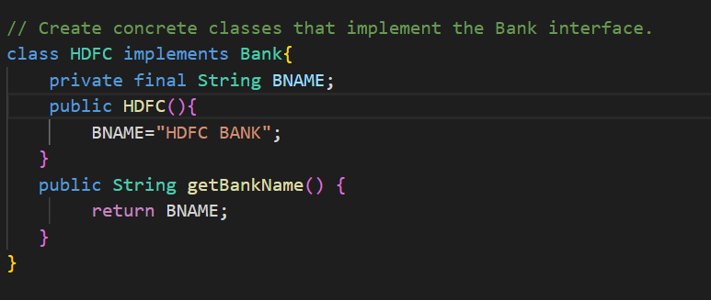

Slide 7


Slide 8
THANK YOU

